Slide 1

Song Clustering
Using K-Means
Luthfi Raditya Meza
081911633055

Slide 2
what is K-Means ?
K-Means is an unsupervised learning algorithm (meaning there are no target labels) that allows you to identify similar groups or clusters of data points within your data. The group based on their distance to the centroid (centroids being defined as the means of the K-clusters).

Slide 3
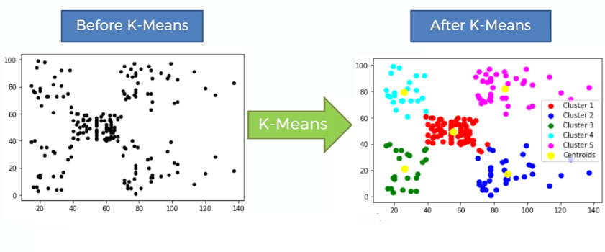
K-Means process

Slide 4

Dataset description :
SpotifyFeatures.csv
genre:the genre of the track
artists_name:The list of artists credited for production of the track
popularity: the popularity rate of the track
danceability:The relative measurement of the track being danceable
energy: The energy of a song - the higher the value, the more energtic
liveness: The higher the value, the more likely the song is a live recording.
valence : The higher the value, the more positive mood for the song.
loudness : the louder the song
liveness : The higher the value, the more likely the song is a live recording.
instrumentalness: The relative ratio of the track being instrumental
tempo : is the speed or pace of a given piece

Slide 5
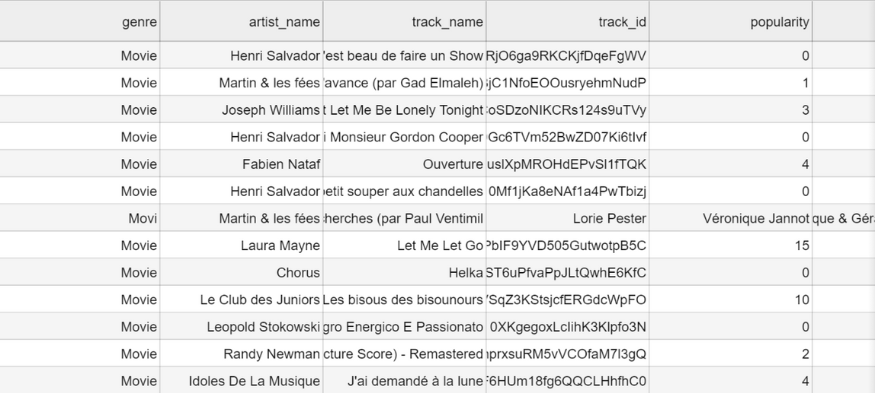
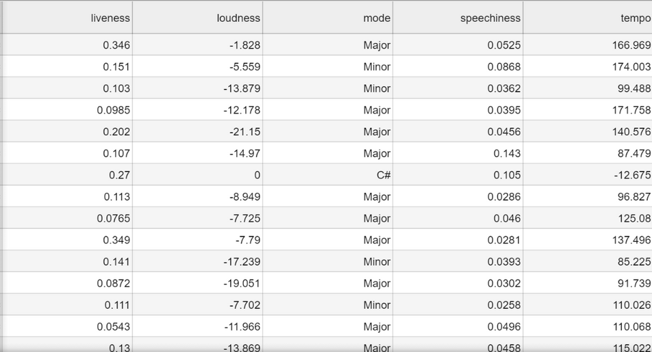
Data overview

Slide 6
Data Preprocessing

Slide 7
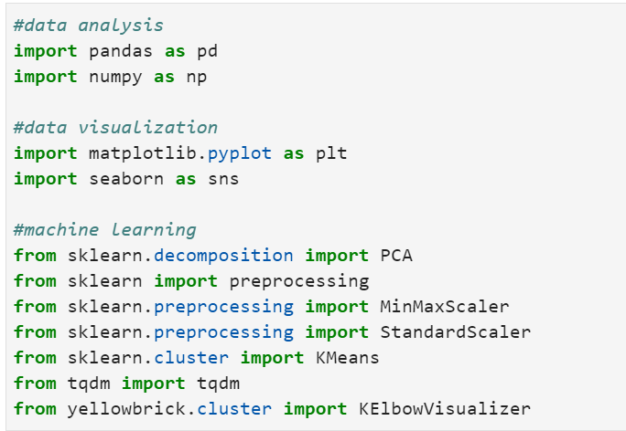
import library
for anlalyzing data we use pandas and numpy library,
visualizing data we use matplotlib and seaborn,
for machine learning mostly we use sklearn.

Slide 8
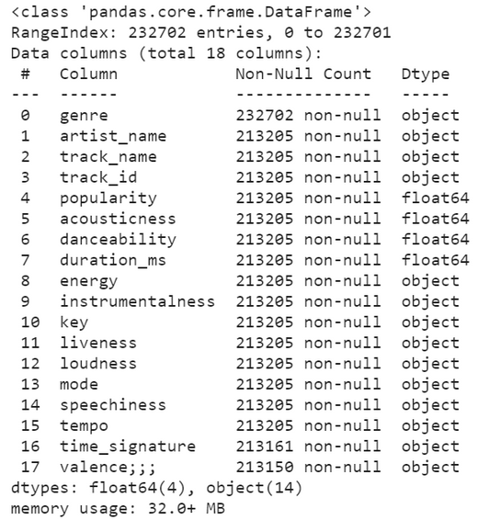
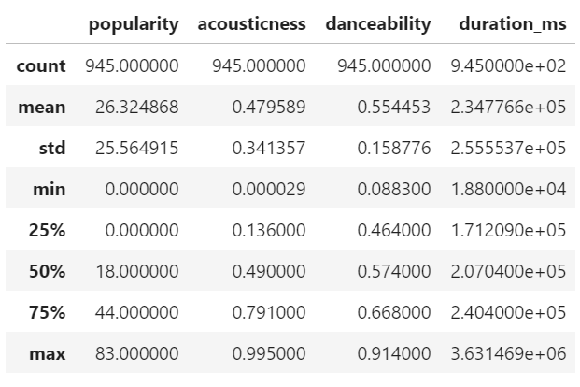

understanding data
our data name is 'df', say hi to'df'.....
To begin this step, I use the info() to get a quick and dirty overview of variable datatypes and describe() to view some basic statistical.
this what's
df.describe()
looks like
this what's df.info()
looks like

Slide 9
Data Cleaning
Data cleaning is the process of fixing or removing incorrect, corrupted, incorrectly formatted, duplicate, or incomplete data within a dataset.
This data is usually not necessary or helpful when it comes to analyzing data because it may hinder the process or provide inaccurate results

Slide 10
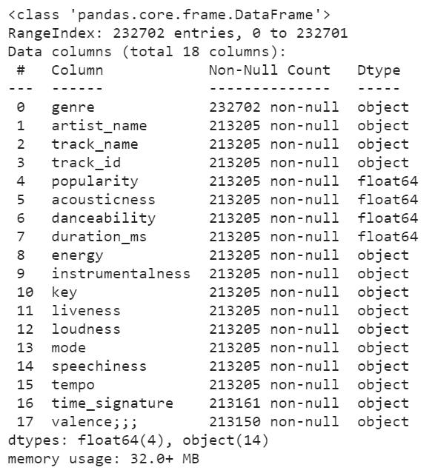
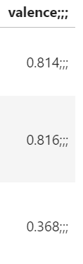
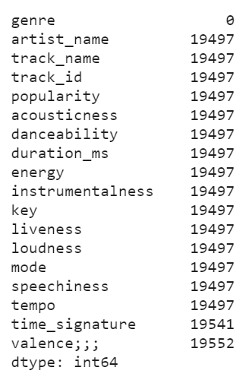
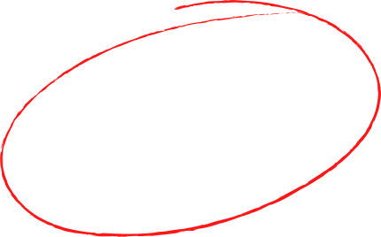
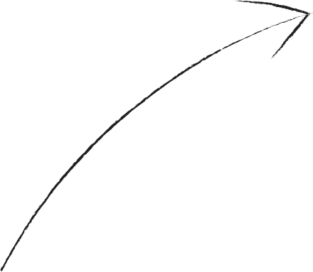
df problem
there are problem in data, we must delete ";;;" so we can convert it into numeric data type
missing value
the data type is object so we can't procces it, we must convert it into numeric data type like float or integer

Slide 11
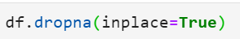
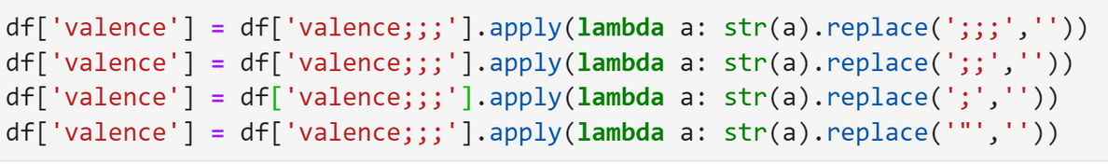
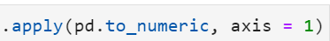
df solution of the problem
1. Missing value
in handling missing value, I use dropna() function to delete all row containing missing values.
2. data format
I use apply(lambda x:) function to replace all uncorrect data
3. data type
in df there are categorical data,we should change it into numeric data using replace() function, so we can convert it into numeric type

Slide 12

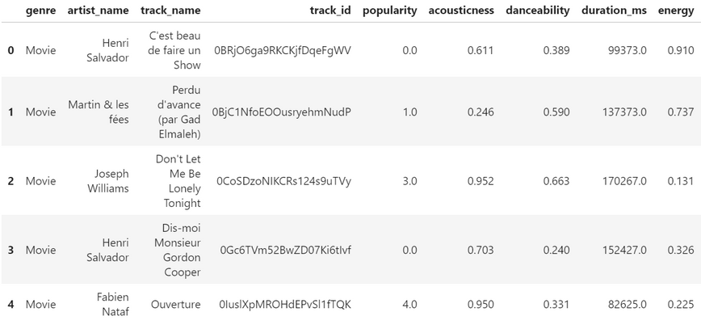
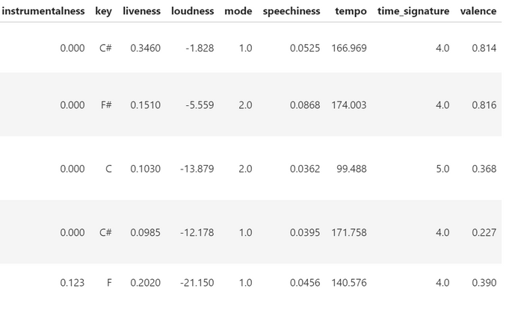
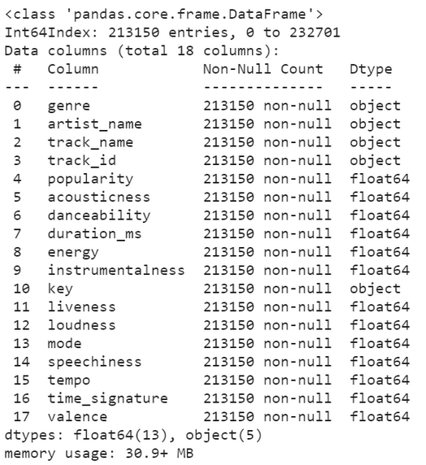
now this is what our df look.....

Slide 13

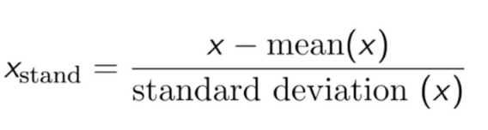
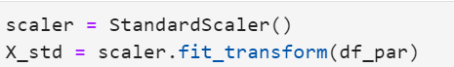
Data Transformation
standardization
standardization is used because it relates to PCA(Principan Component Analysis)
This technique is to re-scale features value with the distribution value between 0 and 1 is useful for the optimization algorithms,
I use StandarScaler from sklearn

Slide 14
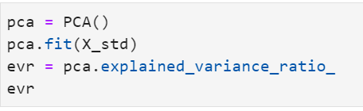
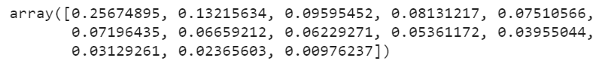
PCA
Principal Component Analysis, or PCA, is a dimensionality-reduction method that is often used to reduce the dimensionality of large data sets, by transforming a large set of variables into a smaller one that still contains most of the information in the large set.
in the previous slide we apply standardization to our data. why? if there are large differences between the ranges of initial variables, those variables with larger ranges will dominate over those with small ranges
evr shows how much variance is explained by each of the fourteen features

Slide 15
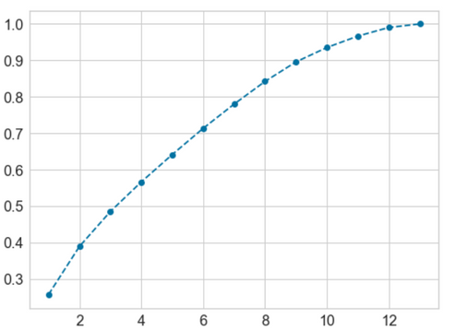
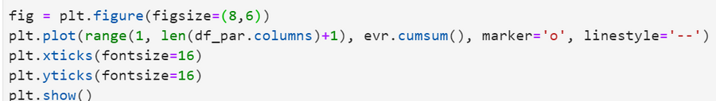
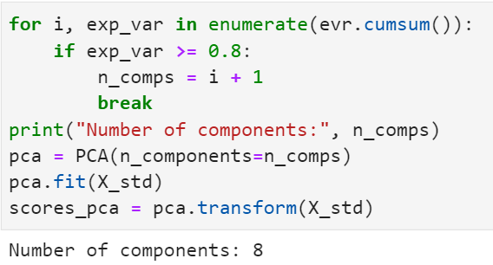
visualization of explained variance ratio
to determine the n_component in PCA we use cumsum() of explained variance ratio.

Slide 16
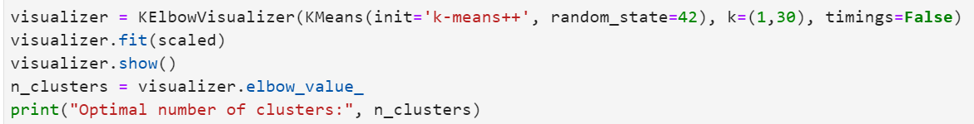
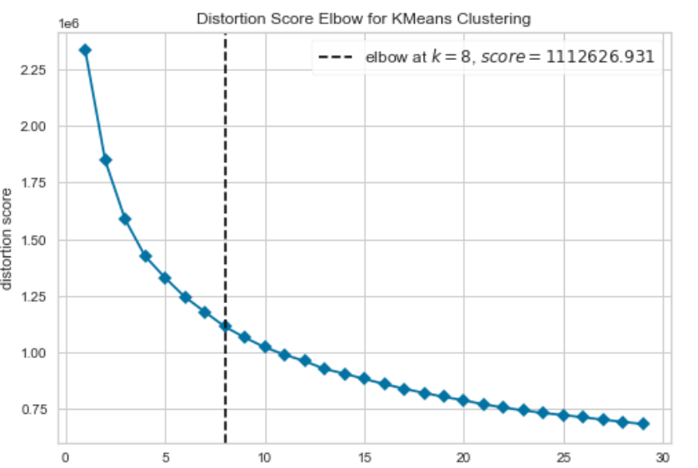
K-Means Clustering
to determine the optimal number of clusters let's use elbow method with distortion( It is calculated as the average of the squared distances from the cluster centers of the respective clusters. Typically, the Euclidean distance metric is used.)
output :
so the optimal number
of cluster K is 8 .....

Slide 17
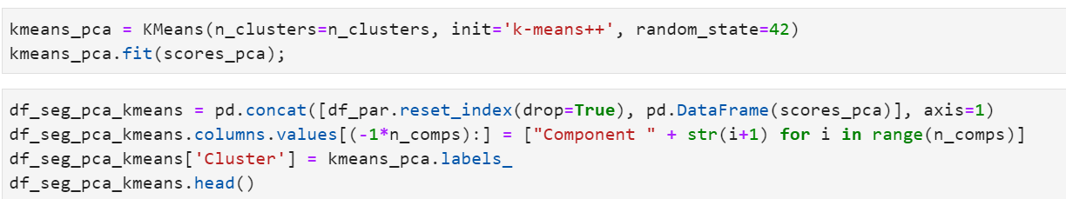
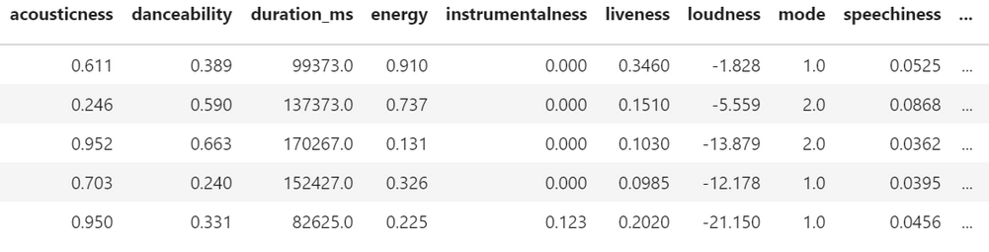
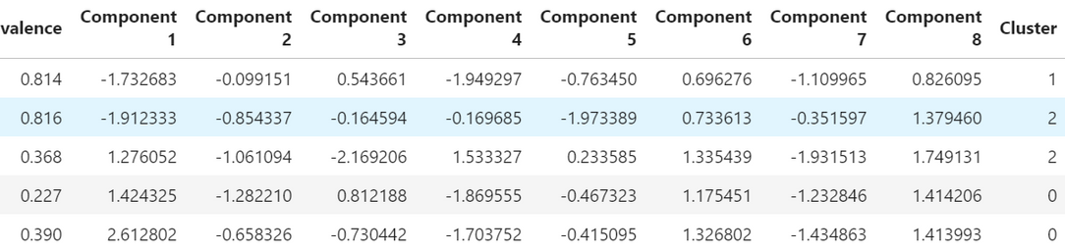
Modelling
let's use PCA components to modelling with K-Means
output :

Slide 18
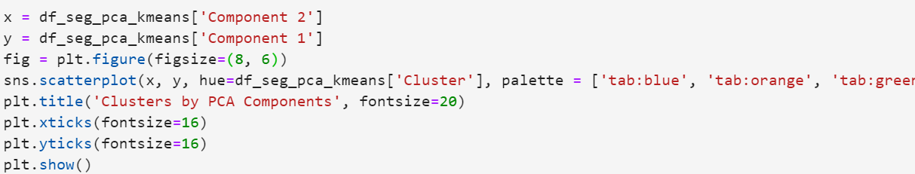
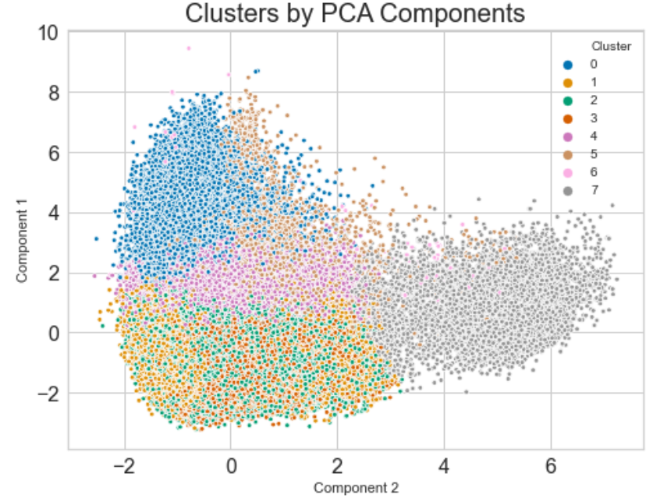
Data Visualization
Data visualization is the graphical representation of information and data

Slide 19
Thank You

